Slide 1




Orion Management Services
Company Profile and Capability

Slide 2
Orion Management Services
Orion Management Services is launched by the team of versatile experienced professionals from IFM industry with a vision to provide comprehensive services with best industry practices. Hands On exposure with reputed organizations, the motive of “Quality & Sustainability” is in total sync with the clients need.
At Orion Management Services, we share a commitment towards the clients need and deliver the same with enhanced response level & audit processes.
Advantages shared as on need basis..
Experienced Professionals with experience in Facility & Property Asset
Management / Service Sector
Extremely Customer Friendly / Customer Centric Approach
Motivated Team Members / Team of SME’s
MIS & Audit Process / Review Meetings

Slide 3
Orion Management Services
The Facility Management vertical has a strong team of technical & HK resources, which is committed to strong service delivery. The Company manages facilities management portfolio spread over Delhi /NCR. The OMS company’s approach to Facility Management extends beyond day to day operations to overall equipment maintenance, life cycle enhancement and capital value protection for our clients.
Our Energy Audit & Engineering serices vertical is an added benefit to serve client needs with expertise and services for comprehensive AMC / O&M services for Power Plants and Industrial facilities covering HT / LT, Steam Systems, Water Treatment Plants and Electrical & Mechanical Utility Systems.
Business also provides Technical Services such as Supervisory Services for Due Diligence, Project Management Services and Technical & Performance Audits.

Slide 4
Mission – Quality & Sustainability
It’s our passion and commitment to our clients to provide quality services through qualitative approach.
We are enthusiast dedicated professionals with scientific approach, which enables us to create Sustainability to be a better “Service Provider Company” , for our clients.
Our Prolonged Experience enables us to provide “ Single Window Solution” to each operational or Administrative issue developed at Residential Sites.

Slide 5
OMS SPECIFIC BUSINESS HANDY INFO
Client Name | Classification | Location
Embassy Warehouse, Farukhnagar, Gurgaon | Logistics Complex | Farukhnagar, Gurgaon
VV Giri Institute , Sector 24, Noida | Educatinal Institute | Noida
Sun city Success Tower, Gurgaon | Business Center | Gurgaon
Yantraa, Noida | IT & BPO | Noida
Punj Lloyd, Gurgaon | BPO | Gurgaon
Unity Group, The Amaryllis, Karolbagh, Delhi | Residential Society | Delhi

Slide 6
OMS SPECIFIC BUSINESS HANDY INFO
Client Name | Classification | Location
Sun City Residentials, Sector 94 Gurgaon | Residential Society | Gurgaon
GSM Mall, Hyderabad | Mall | Hyderabad

Slide 7

Core Value - Our People – Our Asset
”We are committed to nurturing and developing talent at all levels . Our recruitment policy strictly enforces the ethnic mix that ensures local integration whilst maintaining cultural sensitivity. Our senior staff are seasoned facilities management practitioners with applied global and regional experience”.
“At OMS we believe that our people are our core asset. We ensure their skills development through sustainable service deliverance, on the Job training and other talent retention programs” .
Leadership and Mentoring
Technical Excellence
Recruitment
Retention
Management KPIs are developed and devised to foster leadership and nurture talent within team ranks and at all levels throughout the organization.
OMS inculcates the quest for knowledge across all its staff levels. The company is investing substantially within the various technical domains to conduct courses to suit its service enhancement.
OMS recruits international & local experienced people who have the skills, aptitude and talent to secure progression through the organization.
OS implements key employee retention initiatives to ensure stability and excellent customer service delivery

Slide 8
Services OFFERED
Comprehensive Facility Management
Admin & Operations Services / HR services & Payroll mgmt.
Electromechanical Services
HK Services
Security Services
Pantry Services
Horticulture & Landscaping
Façade & Pest Control Services
Risk Analysis & Management
Energy Audit & Conservations
Interior works
Engineering services & Supports
Electromechanical equipments servicing, Repair & Supply
Structural Erections & Civil works
Erection and supply of barricades / Awnings
Floor & structural water proofing
HT / LT equipments repair and AMC, Cables, Bus bars, Breakers and meters
HVAC / Air-conditioning equipments repair & AMC
CCTV , Access control system repair, Boom barriers, Fire panel & systems.
PHE systems repair / replacements
Traffic control – Boom barriers/ Cones etc
Disinfectation & Sanitisation Services
Sanitisation of building internal and external area.
Disinfectation of residential & office , factories & labs, Data Centers, Educational institutes.

Slide 9
Orion Managemnt Services - mehodology
Operations
Management
Converson of Client
desire into
functional
format
for ground
implementations
Administration
In situ -
Specialized
Management
Services
Financial
Management
MIS
Generation
Vendor
Management

Slide 10
OMS - SERVICES POTENTIAL
Mall
ORION MANAGEMENT SERVICES
Property & Asset Management
Financial Management
Project Consultancy
Parking Management
Facility Management
Residential
Commercial
Corporates
Education

Slide 11
KEY POINTS - INTEGRATED FACILITY MANAGEMENT SERVICES
Orion Management Services Offers IFMServices through Operation & Maintenance contract
for all the services shared below.
Technical Services
Financial Management
CAM Budget Analysis
Parking Management
Vendor Management
Occupant Management
Housekeeping Services
Pantry Services
Pest Control
Waste Management
Horticulture Services
Security Services
Façade Cleaning

Slide 12
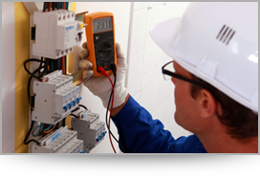
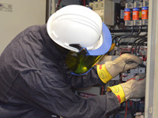
OMS - Operation & Maintenance SERVICES
Technical Services (E&M Services)
DG Systems
HVAC Systems
UPS
Building Management Systems
Fire Alarm System
Electrical System
CCTV System
Plumbing & Water Management
Water Management System – WTP/STP as applicable
Pump Rooms Operations etc.
Usage of proper PPE’s to get the work done at sites
Energy Management
PPM Schedules

Slide 13
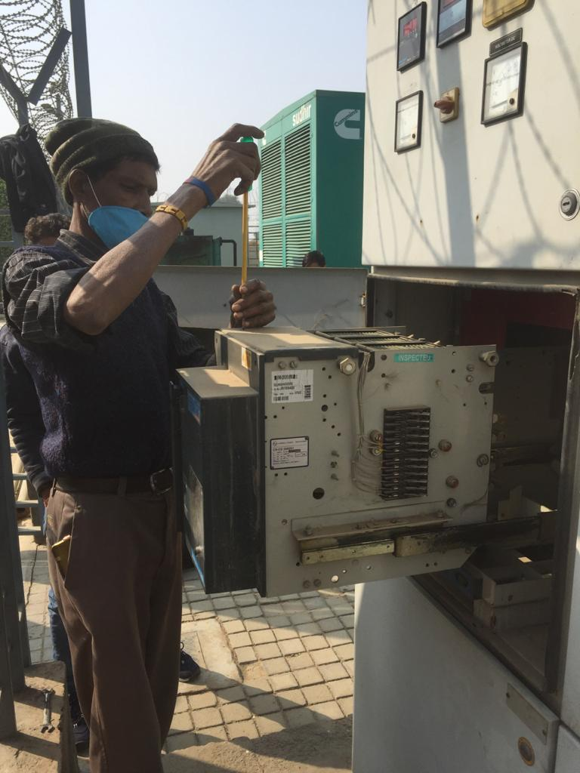
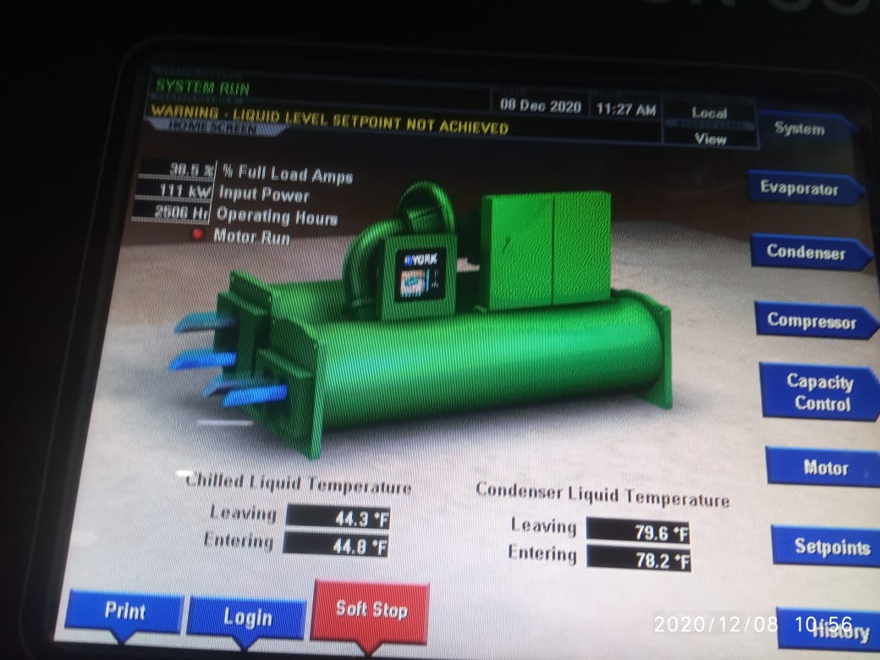
OMS - Operation & Maintenance SERVICES

Slide 14
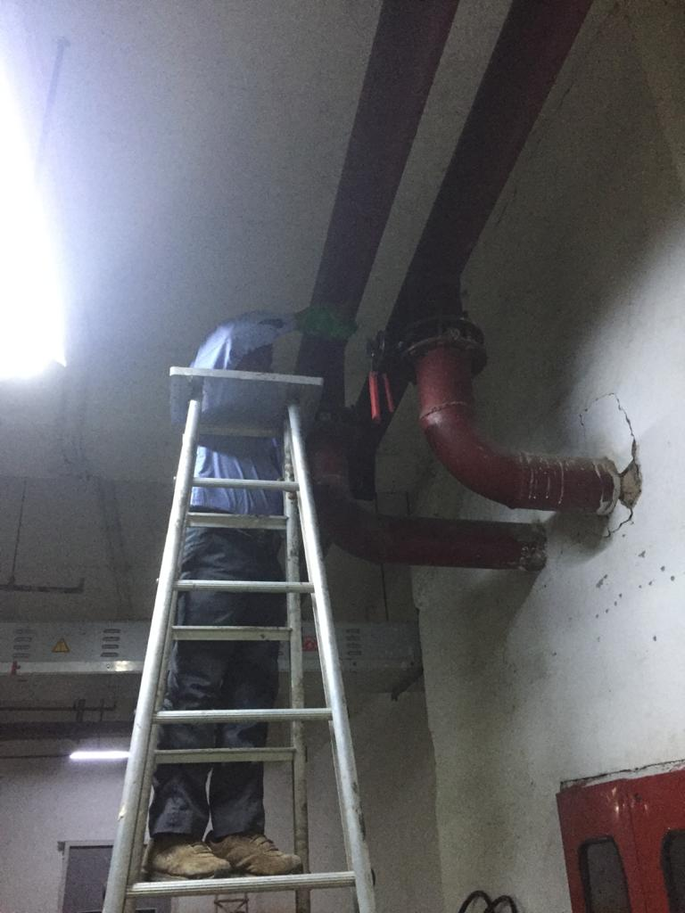
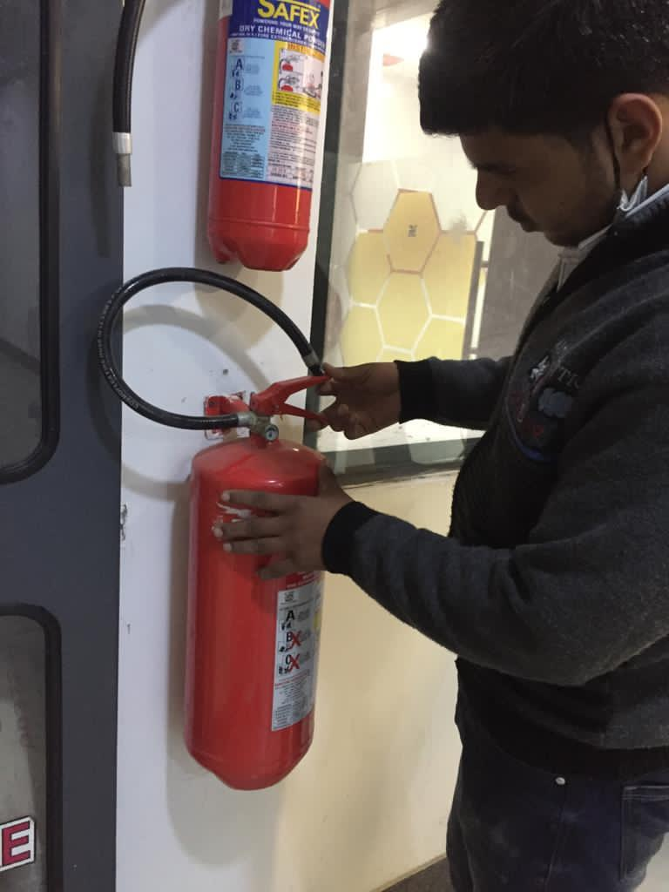
OMS - Operation & Maintenance SERVICES

Slide 15
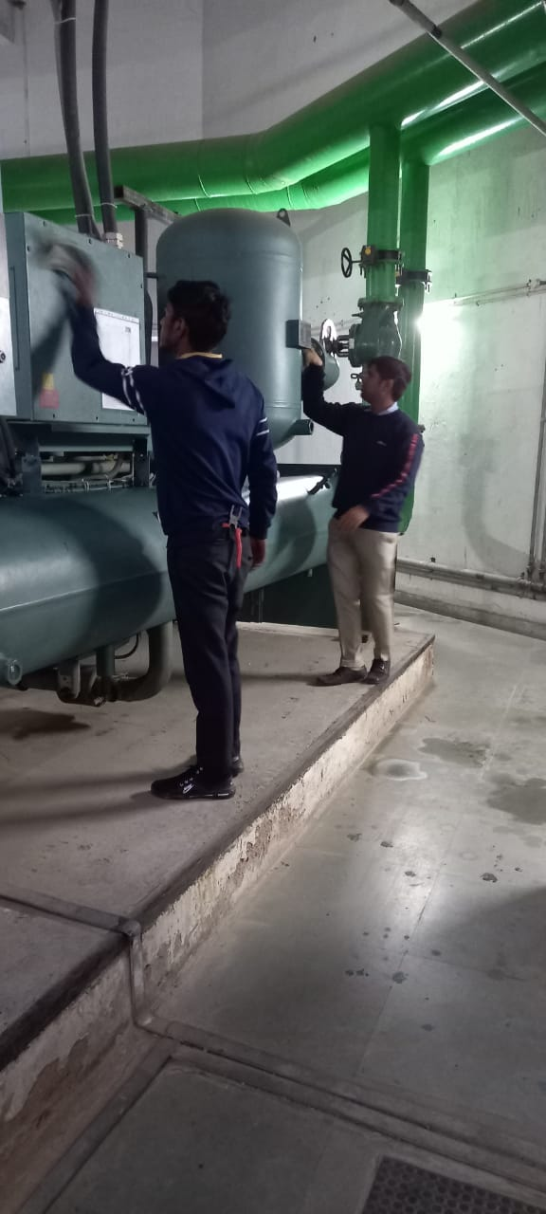
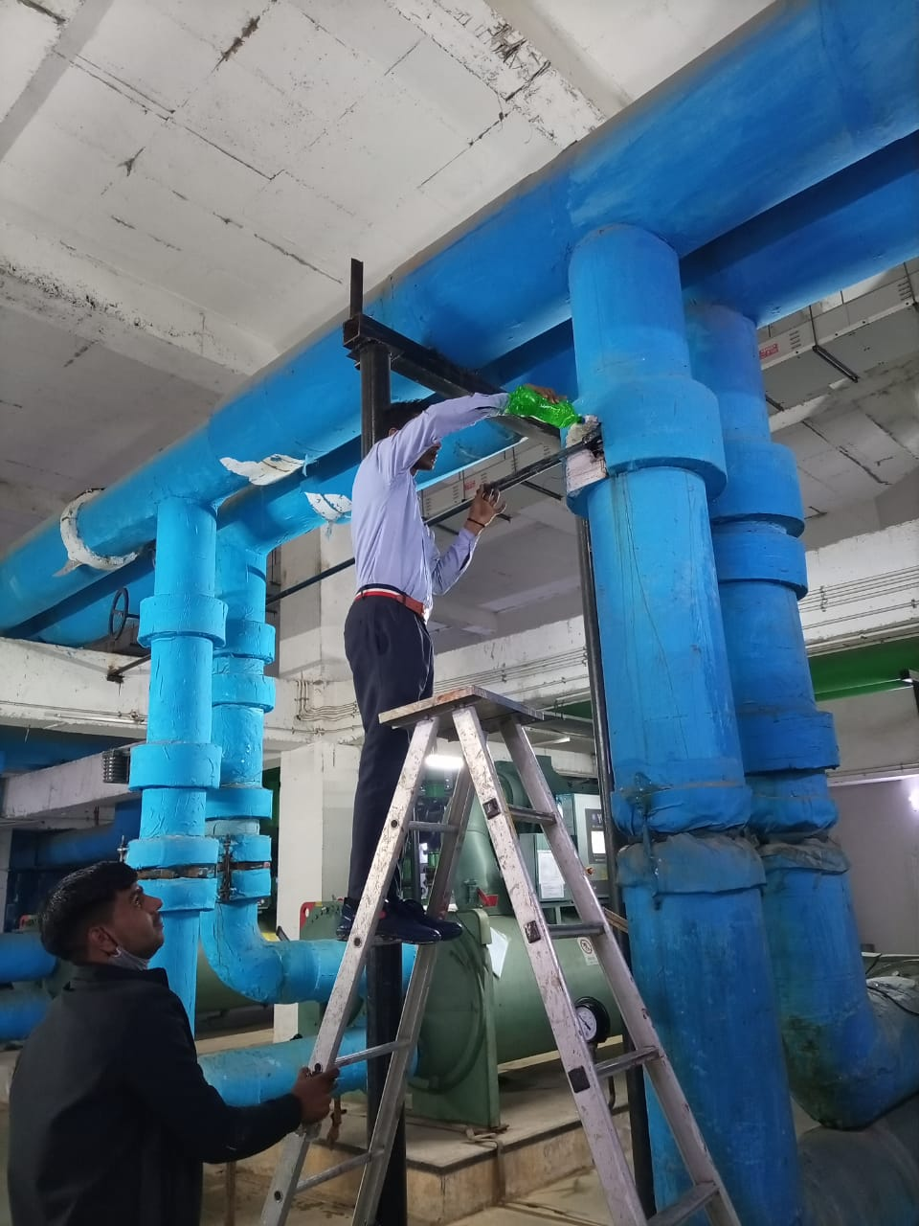
OMS - Operation & Maintenance SERVICES

Slide 16
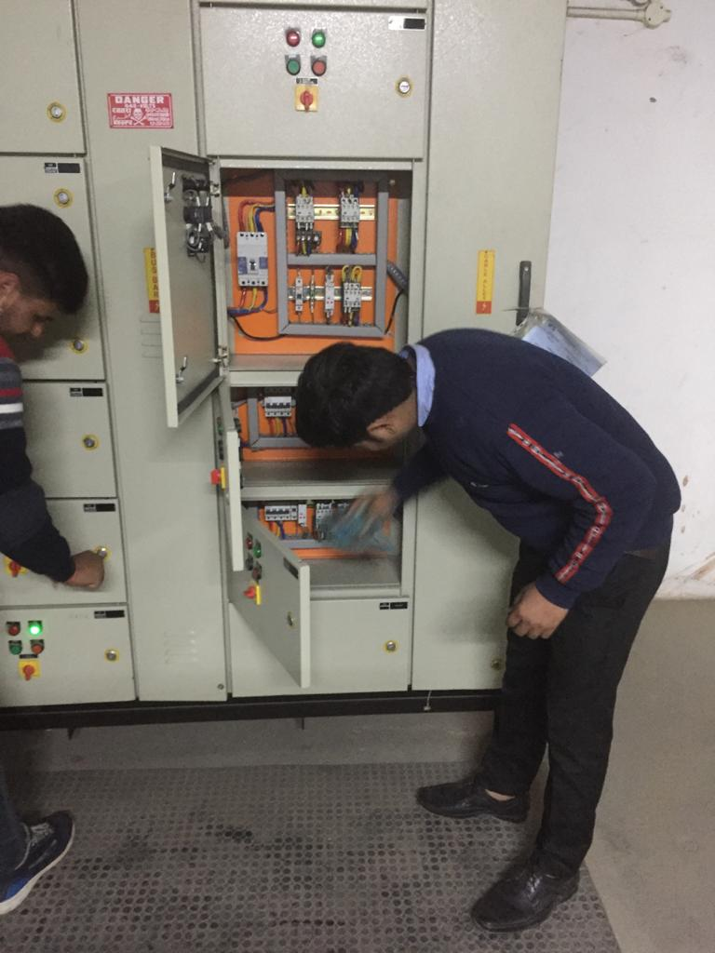
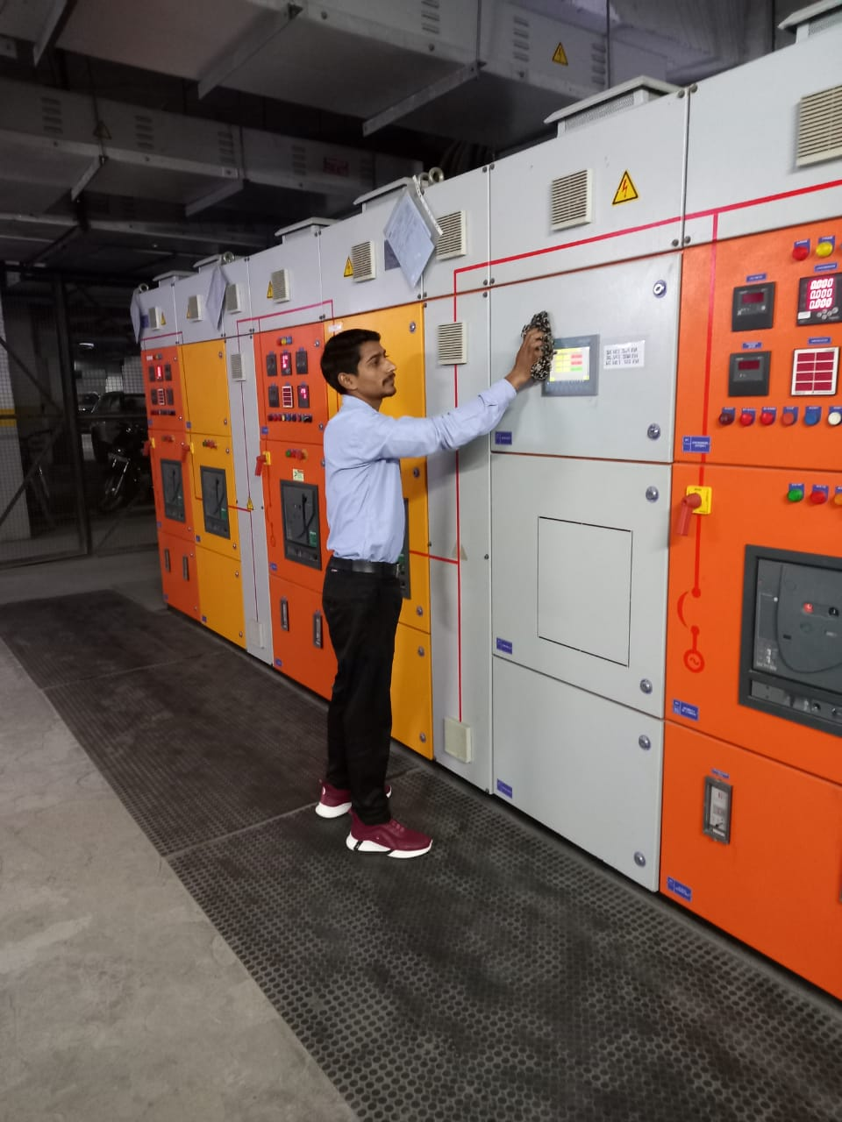
OMS - Operation & Maintenance SERVICES

Slide 17
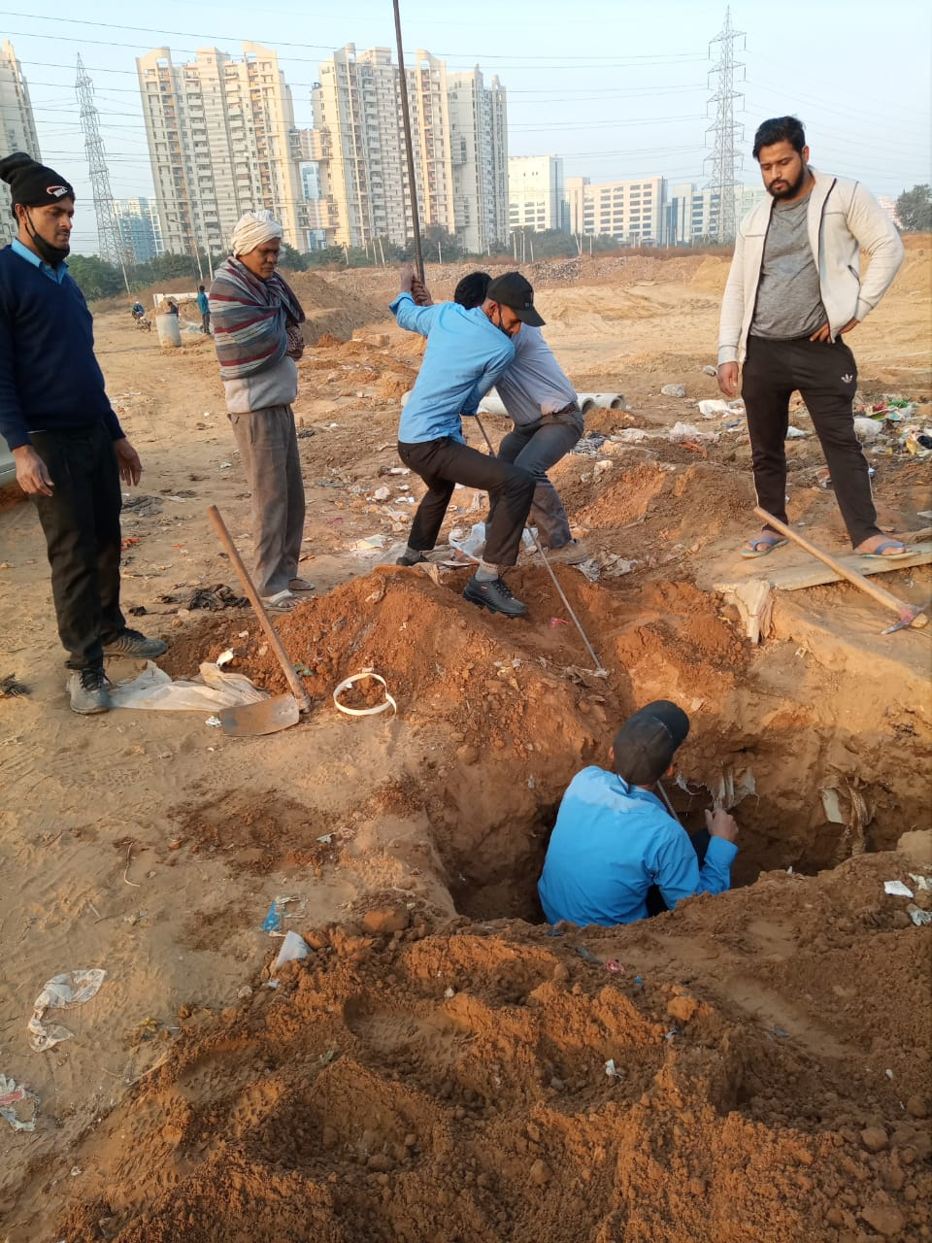
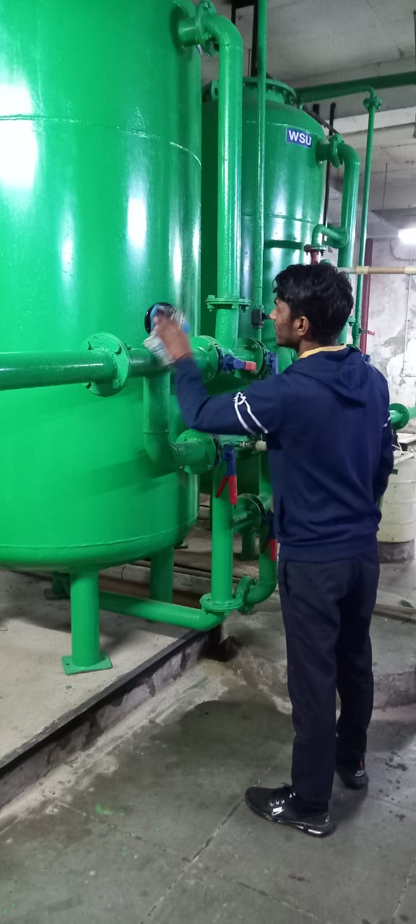
OMS - Operation & Maintenance SERVICES

Slide 18

OMS - HOUSE KEEPING MANAGEMENT
Scheduled Cleaning – Cleaning activity to ensure that all spaces covered under the contract are maintained to a high level of cleanliness & hygiene and remain presentable at all the time. Monitoring on a daily basis to ensure high quality service
Immediate Cleaning - Immediate cleaning activity to maintain safe and secure use of facilities, immediate respond to spillages, replenishing consumables & monitoring the cleanliness of all sanitary facilities
Periodic Cleaning - activity includes all deep cleaning and periodic cleaning activities of the communal & public areas and activities that require more frequent cleaning than routine cleaning including kitchens, vending points and cafeteria
Use of environmental friendly chemicals & consumables ( MSDS adherence )
Service Standards Maintains at all time in good condition to ensure high level of cleanliness and hygiene at all the areas including office area, staircase, toilets, VIP meeting rooms, cabins, reception area, all internal & external area

Slide 19

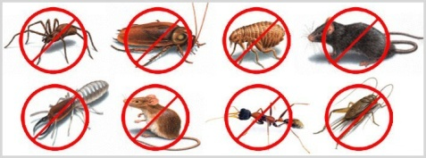
OMS - PANTRY & PEST MANAGEMENT
Pantry Services
Serving tea/coffee etc. to user
Ensure Cleanliness and Maintenance of Pantry, Dining, Cafeteria areas
Ensure all vending machines in pantry, dining, cafeteria area are well maintained
Ensure availability of consumables for all vending machines like tea/coffee etc..
Maintain the consumables inventory to keep the track on consumption and further purchase
Trained manpower is provided for the services
Pest Control
Rodent Control, Flying Insect control, Crawling insect control etc.
Specialized Pest Management for thermal foggings, cold foggings, avicides, herbicides and fumigants etc.
100% strict compliance related to safety norms
Empanelled quality vendors to execute the services at site

Slide 20
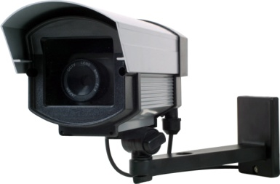
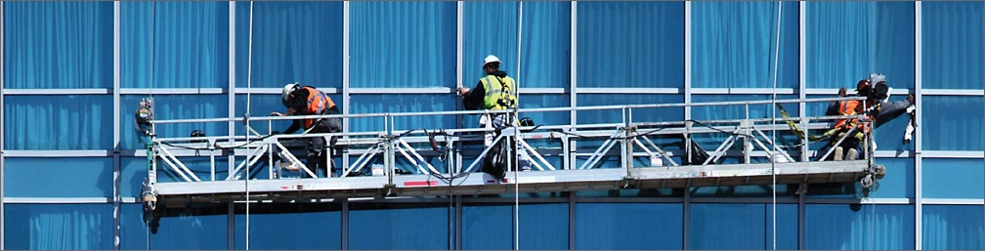
SECURITY SYSTEMS & FACADE CLEAN MANAGEMENT
Ensure Safety & Security of Entire facility 24 X 7
Physical Security
Patrolling of Facility
Securing all Entry & Exits of the facility
Frisking of employees/visitors
Inspection of Vehicles entering in the facility
Maintain proper record for all the employees and visitors entering into facility
Conduct Fire/Emergency Drills at site
Ensure Fire/Emergency assembly area is easy approachable by all
Monitoring all the safety assets installed at site like CCTV, Access card etc.
Site Key Management
Façade Cleaning
Use adequate equipments for proper safety at work
Cleaning of High rise/Low rise façade with trained and well equipped manpower
100% strict compliance related to safety norms

Slide 21
OMS - TRANSITION SUPPORT & QUALITY CONTROL PROCESS
System Integration & Transition
Manpower Deployment Service
Operation Service
Other Services
Constant Consultancy for quality & Sustainability
Maintenance Service
Quality with Expertise Team work
Knowledge with Integrity
Best Resource management with commitment
OMS
OPERATIONAL SUPPORT
Project Management.
Quality Assurance. Ÿ Work Supervision. Ÿ Value Engineering
Material Management.
Cash Flow Management.
Quality Management
Risk Management.
EHS Managemen

Slide 22
OMS - CONTRACT MODULE - AS YOU NEED
Comprehensive Facility Management
CFM & IFM services / O&M contracts with complete setup with M&E / HK / Security & Horticulture manpower.
Facade cleaning services
Pest Control , Covid 19 Sanitisations & Disinfectation services
Human Resource
HR Payroll Management
Recruitment & deployment
CNP Model for payroll management

Slide 23

Orion Management Services
Office Address: F-412, SGM Nagar, NIT, Faridabad, Haryana - 121001
Web mail - HDOMS.INFO@GMAIL.COM
Web - www.orionmanagementservices.org
Contact us: +91- 8799705931 / 9899380761

